Slide 1
Digital Battery Passports
Team 20
Inversity Challenge

Slide 2

Consumer Persona - Anna
Nurse looking for a second-hand EV but ‘worried’ about the state of the used battery
Pain Points – Difficult to understand the status of the battery from previous owners
Goals – Wants to to easily ascertain the status of the battery from a previous owner.

Slide 3

Enterprise Personas - Tess
Warehouse manager looking for efficiency savings in managing electric batteries
Pain Points: Managing inventory of batteries for various devices, ensuring timely replacement, minimizing disruptions in operations.
Goals: Implement a program to track battery usage, monitor performance, and streamline replacement processes.

Slide 4
Mission Statement
“Give insight into a battery's history to determine its status, history and suitability more effectively.”

Slide 5
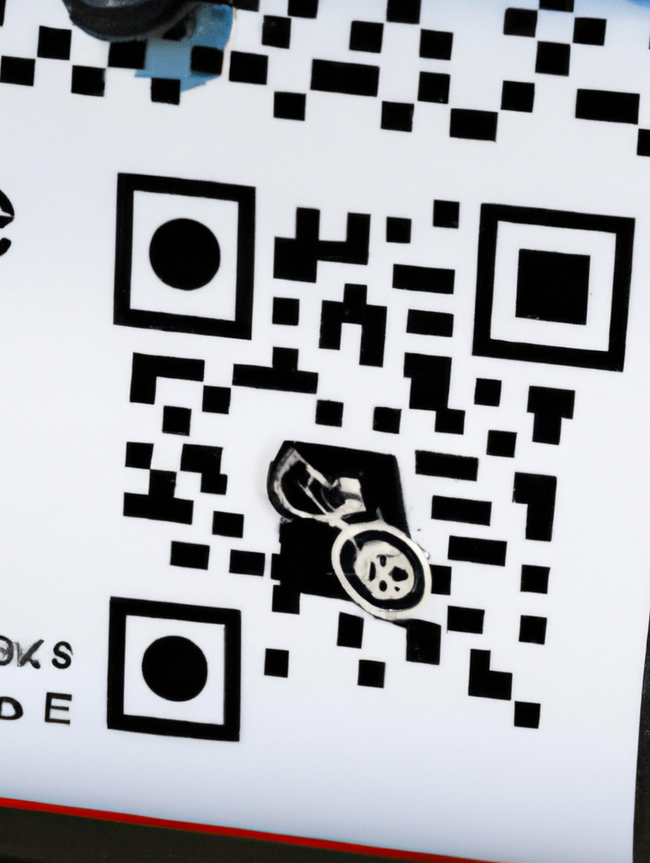
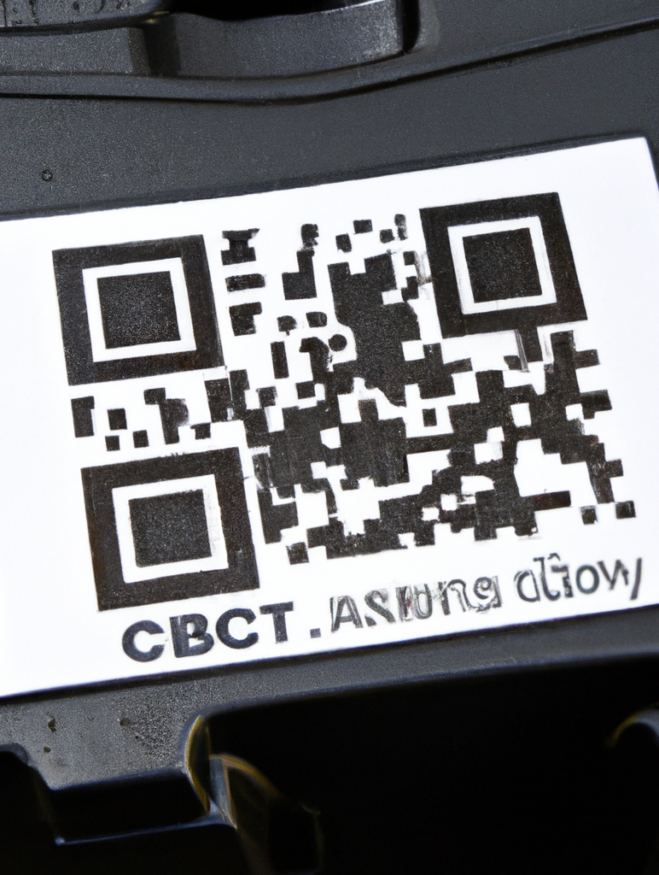
Product
Scannable QR code on each battery
Mobile web site
Like a digital MOT history but specific to electric car batteries
Allows view and addition of new battery data.
Eco benefits (48% of batteries are recycled or repurposed)
User can make an informed decision on the battery

